Slide 1
THANK YOU FOR DOWNLOADING OUR SLIDES
Please note: the information contained within this presentation was accurate at the time of the Open Day (November 2025). In some instances, information can be subject to change and the University reserves the right to make amendments as required.
For the most up-to-date course information (such as course structures, entry requirements and modules), please visit bristol.ac.uk/economics.

Slide 2
DISCOVER
ECONOMICS
AT BRISTOL

Slide 3
WHY STUDY
ECONOMICS?

Slide 4

What three words describes what economics is about?

Slide 5
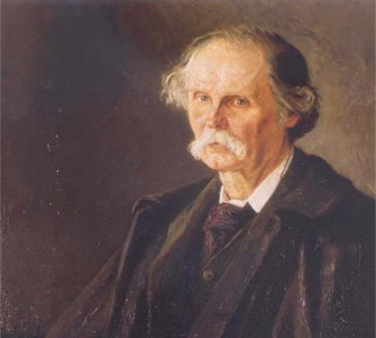

“The study of man in the ordinary business of life”
Alfred Marshall (Principal and Professor of Economics, University College Bristol, 1877–1883)

Slide 6
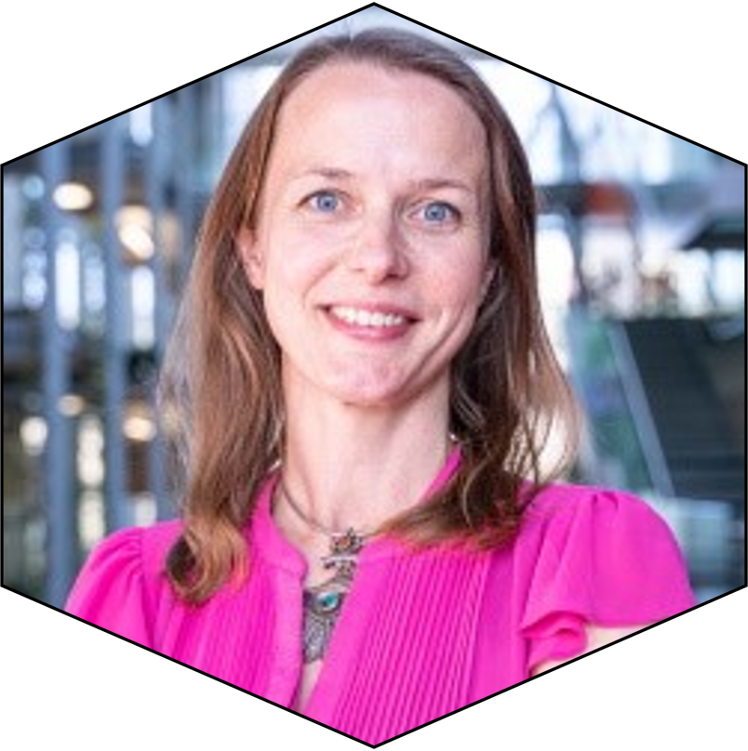
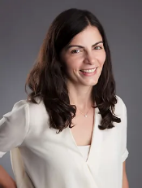




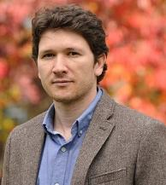




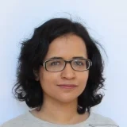

What is economics?
Prof. Stephanie von Hinke
How do genes and environment interact in childhood development?
Prof. Christine Valente
How can we help increase school attendance in southern Africa?
Dr Arnaud Phillipe
How can we improve judges’ sentencing decisions?
Dr Battal Dogan
How should we best allocate Covid vaccines around the world?
Dr Kevin Tran
How does Airbnb compete with local hotels?
Dr Zahra Siddique
How does female labour force participation respond to media reports of violence in India?

Slide 7
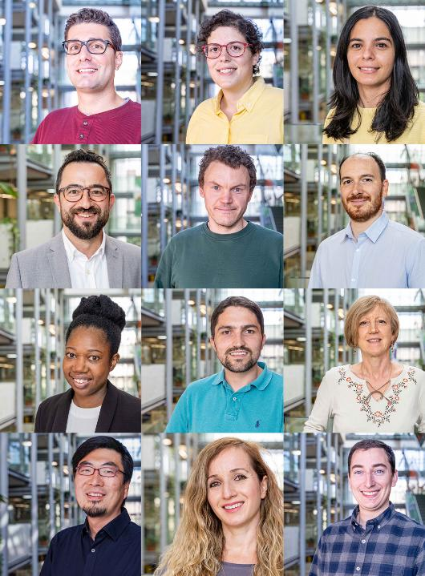
…and much more
LABOUR ECONOMICS / GENETICS / EDUCATION POLICIES / HEALTH / ECONOMICS OF CRIME / EARLY CHILDHOOD DEVELOPMENT / TECHNOLOGICAL CHANGE / TAX AND BENEFIT SYSTEMS / INEQUALITY / BEHAVIOURAL ECONOMICS / NONPARAMETRIC ECONOMETRICS / CHARTIABLE GIVING / DOMESTIC VIOLENCE / DEVELOPMENT ECONOMICS / POLITICAL ECONOMY / UNEMPLOYMENT INSURANCE / MACHINE LEARNING / ECONOMIC HISTORY / HETERODOX ECONOMICS / URBAN DEVELOPMENT / INDUSTRIAL ORGANISATION / REVEALED PREFERENCE METHODS / MECHANISM DESIGN / PERFORMANCE PAY / GENDER / MIGRATION

Slide 8
Economic models
Conceptualise complex issues in terms of simplified models of behaviour
Evidence
Test model predictions using data (econometrics)
Implications
Draw out implications for policy and practice
ANALYTICAL SKILLS
QUANTITATIVE SKILLS
COMMUNICATION SKILLS

Slide 9

Economics graduates enjoy a broad choice of destinations
Finance and banking
Public policy
NGOs and development organisations IMF, World Bank
Accounting and Consultancy
Industry and big tech
Media
They are also amongst the highest paid. After 5 years, the average salary for Bristol Economics graduates is £57,500, 28% more than average for UK Economics grads (discoveruni.gov.uk, 2025)

Slide 10
WHY STUDY
ECONOMICS
AT BRISTOL?

Slide 11

Three reasons to choose economics at Bristol
Our teaching
Your bright future
Our academic reputation

Slide 12
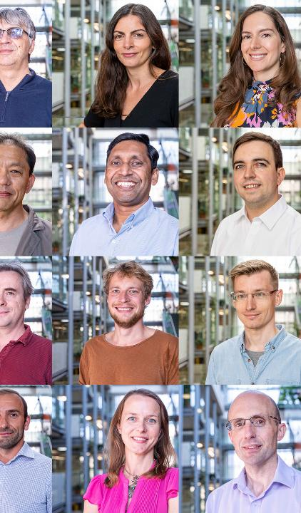
Our academic reputation
Our research
Over 97% of Bristol’s Economics and Econometrics research is rated either “world leading” or “internationally excellent”. (REF 2021)
Our rankings
Our world-class experts
Top 5 in UK for Economics and Econometrics research output (REF 2021)
Top 5 in UK for Economics and Econometrics "world leading" impact (REF 2021)
2015 Nobel prize winner, Angus Deaton is a former Bristol professor
Be taught by people whose cutting edge research is changing policy and practice

Slide 13
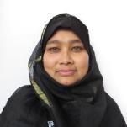
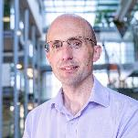

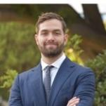
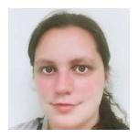
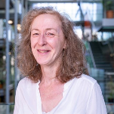
Our teaching
Dr Rabeya Khatoon
UK Advising and Tutoring Awards 2022 – Innovation in Advising (Winner)
We will challenge you
Technically rigorous approach to teaching Economics
Delivers transferable skills (analytical, quantitative, data-handling, programming)
We will support you
Academic and pastoral support and guidance in the School
Student Support Manager shortlisted for University award
University Wellbeing Service
We are innovative
We regularly review and update what we teach
E.g. new offer courses in data skills and communicating economics
Dr Steven Proud
Economics Network Teaching Awards 2019 – Outstanding Contribution to Economics (Winner)
Dr Ruth Badru
Economics Network Teaching Awards 2019 – Best New Lecturer (Commendation)
Dr Pietro Spini
Bristol Teaching Awards 2023 – Inspiring and Innovative Teaching Award (Shortlisted)
Dr Annika Johnson
Economics Network Teaching Awards 2021 – Special Commendation for Contributions to Economics Teaching and Learning During the Pandemic
Rachel Cardew
Bristol Teaching Awards 2022 – Outstanding Support Award (Shortlisted)

Slide 14
Our degree programmes
BA Economics (new 2026!)
Quantitative and rigorous Economics degree for those without A-level maths
Embeds accelerated learning of Maths/Stats required for modern Econ
Focus on Economics
BSc Economics
BSc Economics and Econometrics
Core Economics and in-depth Maths/Stats
Increasing flexibility to specialise or diversify as move through the degree
BSc Economics and Data Science (new 2026!)
Core Economics and in-depth Maths/Stats
Training in modern programming languages, applied to economic analysis
Final year project: tackle a real-world data challenge
Combine with another subject
BSc Economics and Finance
BSc Economics and Mathematics
BSc Economics and Management
BSc Economics and Politics
BSc Economics and Accounting
BSc Philosophy and Economics
MSci Economics with Innovation
Core Economics and Maths/Stats
Dedicated curriculum in a second subject

Slide 15
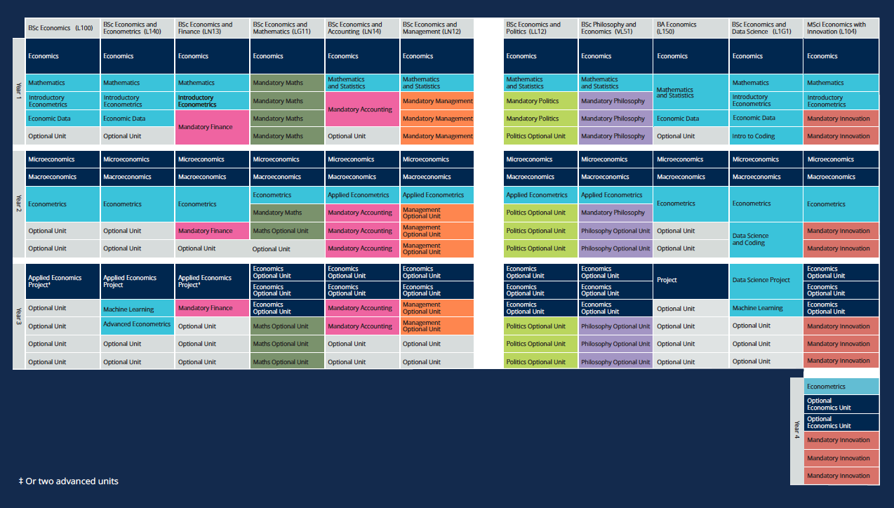

Slide 16
Example: BSc Economics*
Economics
Microeconomics
Applied Economics Dissertation
(or 2 advanced units)
Economics
Macroeconomics
Mathematics
Econometrics
Optional Unit
Intro Econometrics
Econometrics
Optional Unit
Economic Data
Optional Unit
Optional Unit
Optional Unit
Optional Unit
Optional Unit
+ Office Hours
+ Revision Sessions
+ Employability Sessions
+ Extra-curriculars…
120 credits per year (typically 6 units per year, 3 per term)
Variety of teaching styles (large group, small group, labs, clinics)
Assessed through combination of coursework and exams
*This is an indicative guide of our 2025/26 course structures. For unit information, please visit bristol.ac.uk for the latest list of available options.

Slide 17
ECONOMICS
ACCOUNTING & FINANCE
ENVIRONMENTAL ECONOMICS / BEHAVIOURAL ECONOMICS / MACHINE LEARNING / COMMUNICATING ECONOMICS / APPLIED MICROECONOMICS / GROWTH AND DEVELOPMENT / ECONOMICS OF DEVELOPING COUNTRIES / PUBLIC ECONOMICS / TOPICS IN APPLIED ECONOMICS / INTERNATIONAL ECONOMICS / GLOBALISATION AND DEVELOPMENT / ECONOMIC HISTORY / INDUSTRIAL ECONOMICS / HISTORY OF ECONOMIC THOUGHT / ADVANCED ECONOMETRIC THEORY / ADVANCED MICROECONOMICS / LABOUR ECONOMICS / FOUNDATIONS OF ECONOMETRIC THEORY / ECONOMIC HISTORY / PHILOSOPHY OF ECONOMICS
PRINCIPLES OF FINANCE / DERIVATIVES / MANAGEMENT ACCOUNTING FOR STRATEGY / FINANCIAL ACCOUNTING / FINANCIAL CRISES / AUDITING / PORTFOLIO MANAGEMENT / ADVANCED FINANCIAL REPORTING / ADVANCED CORPORATE FINANCE / INTERNATIONAL FINANCE
MANAGEMENT
OPERATIONS MANAGEMENT / ADVANCED MANAGEMENT SCIENCE / PUBLIC MANAGEMENT / INTERNATIONAL BUSINESS MANAGEMENT / MANAGEMENT SCIENCE / FOUNDATIONS OF BUSINESS LAW
*This is an indicative guide of optional units for 2025/26. Options vary by programme. For unit information, please visit bristol.ac.uk for the latest list of available options.

Slide 18

Beyond the classroom
Activities and Societies
School-led events
Thriving network of student societies connected to the School
Career talks and networking events
Academic Skills and Software
Regular office hours with lecturers and tutors
Advanced software workshops (e.g. Excel, Python, R)
Academic writing guidance
SAGE: Student Assisted Guidance in Economics

Slide 19




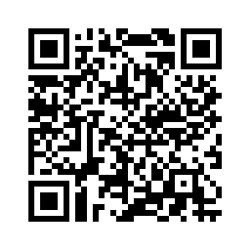
Opportunities to study abroad
Year abroad:
Most of our programmes allow students to spend a year studying abroad.
Previous study abroad destinations have included:
Australia, USA, Singapore, South Korea, Hong Kong, Taiwan, Bangkok, Denmark, France, Belgium, Italy, Netherlands and Poland
Summer opportunities:
We also offer summer abroad opportunities through our Bristol Abroad team
https://www.bristol.ac.uk/centre-for-study-abroad/outbound

Slide 20
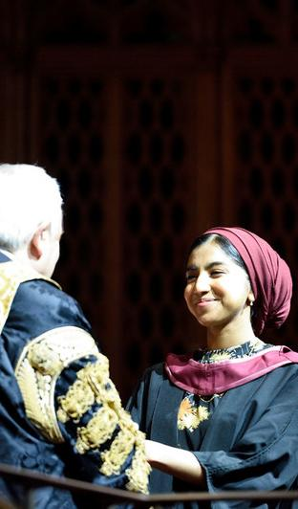



Your bright future
Bristol graduates are fifth most targeted by top UK employers (High Fliers 2024)
94% of our 2021/22 economics graduates in employment or further study after 15 months (Graduate Outcomes Survey, 2023)
Mean salary £57,500 after 5 years, 28% more than average for UK Economics grads (discoveruni.gov.uk, 2025)

Slide 21
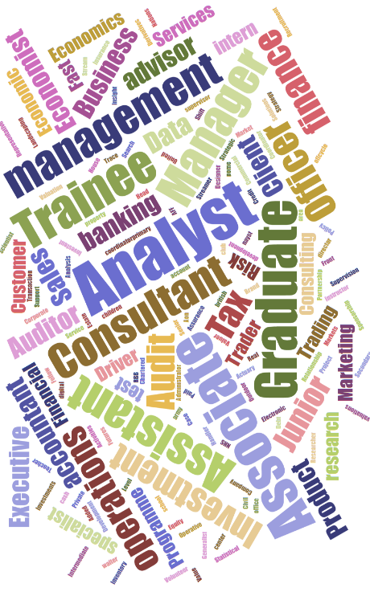
Example graduate destinations
Your bright future
Where do our graduates work?
Where do our graduates go for postgraduate study?
Amazon Web Services | Microsoft
Office for National Statistics | Government Economic Service
Bank of England | Goldman Sachs
BCG | EY
University College London | London School of Economics
University of Oxford | University of Cambridge
Graduate Outcomes Survey 2022 (for School of Economics UG)

Slide 22

Your bright future
Careers Service
Professional Liaison Network
Student societies
General support and advice
Access to major employers
Careers Fairs
CV workshops
Subject-specific Opportunities
Professional Mentoring
Alumni Talks
Career events
Student Societies: EFM, Bristol FinTech, Bristol Investment Society
School of Economics networking events

Slide 23
ADMISSIONS INFORMATION
BSc Economics
BSc Economics and Econometrics
BSc Economics and Data Science
MSci Economics with Innovation
A-level standard offer: A*AA (inc. Maths)
A-level contextual offer: AAB (inc. Maths)
BSc Economics and Maths
A-level standard offer: A*A*A (inc. A* Maths and A in maths-related subject) or A*AA (inc. A*A in Maths and Further Maths in any order)
A-level contextual offer: AAA (inc. Maths and maths-related subject) or
AAB (inc. AB in Maths and Further Maths in any order)
BSc Economics and Politics
BSc Philosophy and Economics
BSc Economics and Finance
BSc Economics and Management
BSc Economics and Accounting ​
A-level standard offer: AAA (inc. Maths)
A-level contextual offer: ABB (inc. Maths)
BA Economics
A-level standard offer: A*AA (with a 7 or A at GCSE maths)
A-level contextual offer: AAB (with a 7 or A at GCSE maths)
To find out if you are eligible for a contextual offer, visit bristol.ac.uk/contextual-offers.

Slide 24
ADMISSIONS INFORMATION
How we assess your application
Applications are scored and ranked based on your academic record, according to your achieved or predicted results with the following weightings: ​GCSE 20% | A-level 80%. This calculation will give us a score which we'll use to compare applications.​
​
Personal Statement
The work you put into preparing and composing your personal statement is an important part of deciding what you want to study and where. ​At Bristol, we consider personal statements in our assessments if we need to differentiate between applicants for the final few offers.​
For subject-specific admissions information, visit ​bristol.ac.uk/admissions-statements

Slide 25
THANK YOU
Visit us at Beacon House between 09:30 – 16:00
Visit us online: www.bristol.ac.uk/economics
Email us: choosebristol-ug@bristol.ac.uk
Follow us on Instagram: bristoluni_economics
Follow us on Twitter: @BristolUniEcon

